Slide 1

Employees Review by Manager

Slide 2

Data Collection By HR
HR of the company collects a data by various method to gather information of employee.
This data gives them information
and valuable insight and will be used for further analysis

Slide 3

“Satisfaction Catalyst : Data-Driven Analysis and Future Forecasting”

Slide 4
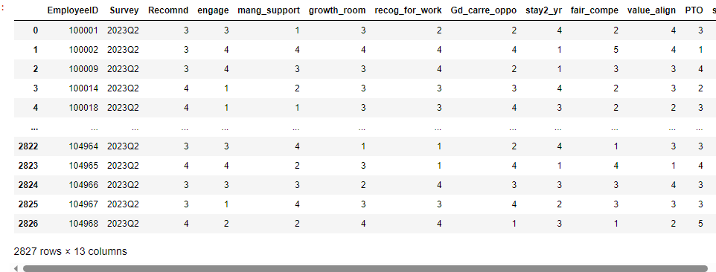
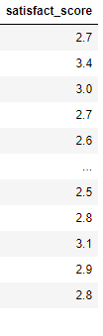
Let me Introduce the data…

Slide 5
Data Pre-processing
Data
Completion
Data
Reduction
Data
Transformation
Data Noise
Reduction

Slide 6
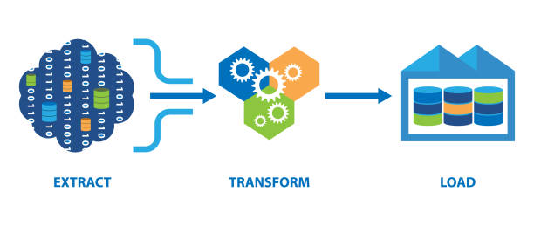
Data Transformation
Salary Log Transformation.
Normalization of Data .
Creating a new column.
.

Slide 7

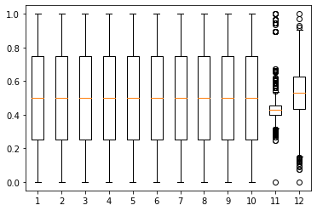
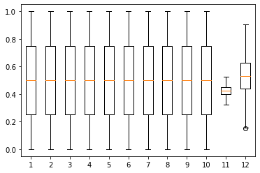
Data Noise Reduction
Missing Values
Outlier Detection & Treatment
Detection
Treatment
1.IQR
2.Modified z-score
1.Remove outlier
2.Impute by Trimmed mean

Slide 8

Exploratory Data Analysis.
Exploratory data analysis (EDA) is used by data scientists to analyze and investigate data sets and summarize their main characteristics, often employing data visualization methods.
It can help identify obvious errors, as well as better understand patterns within the data, detect outliers or anomalous events, find interesting relations among the variables.

Slide 9
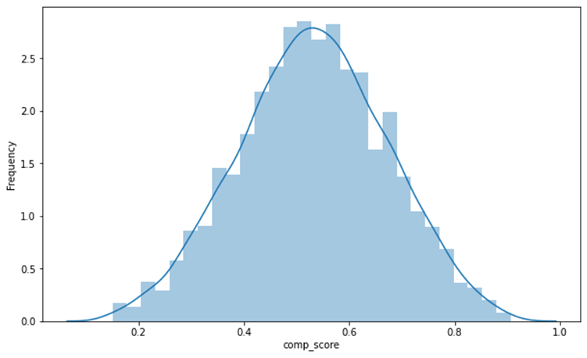
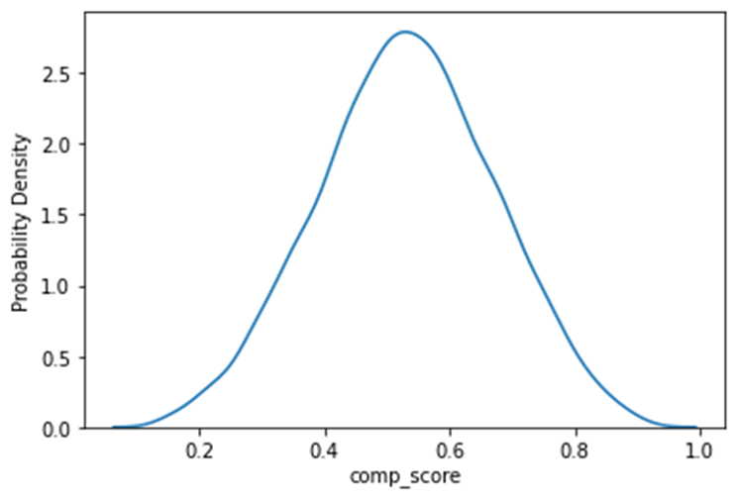
Distribution of Response Variable

Slide 10
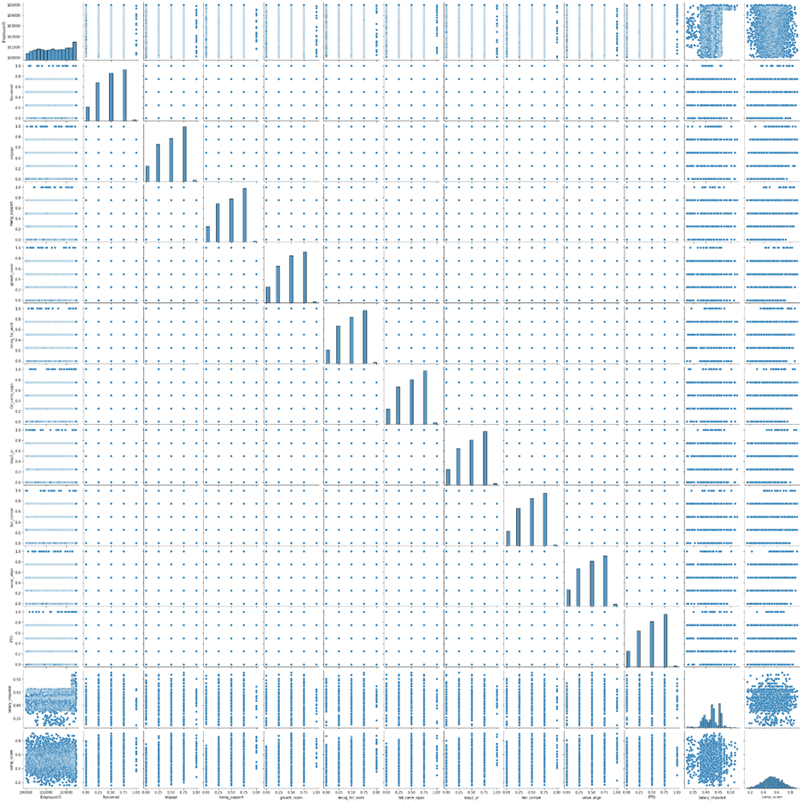
Pair-Plot

Slide 11
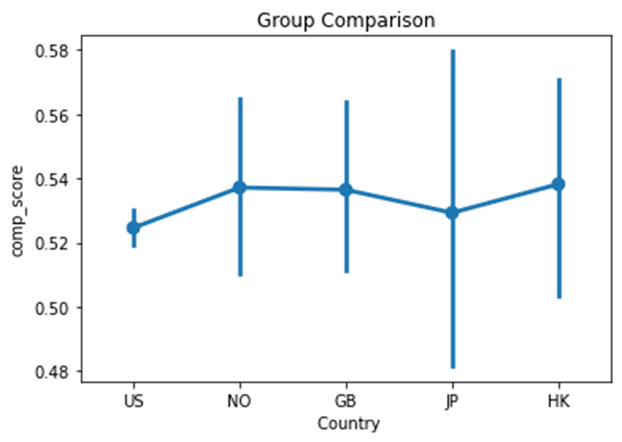
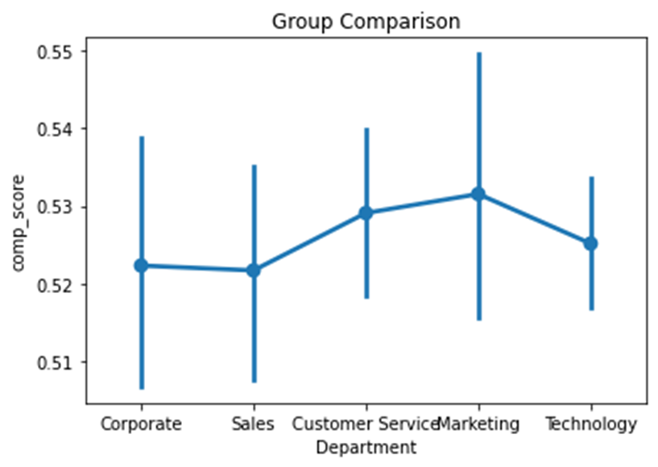
Group Visualization

Slide 12
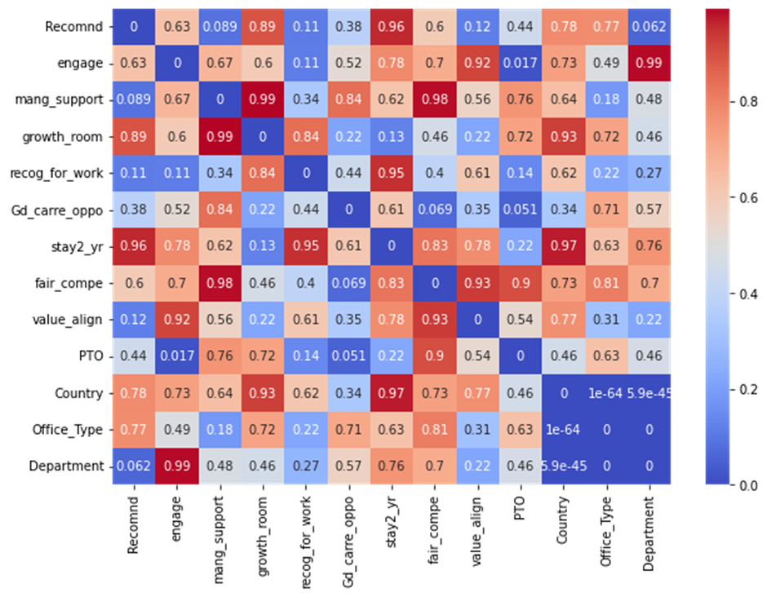
Heat-map of Independency between Categorical Variable

Slide 13
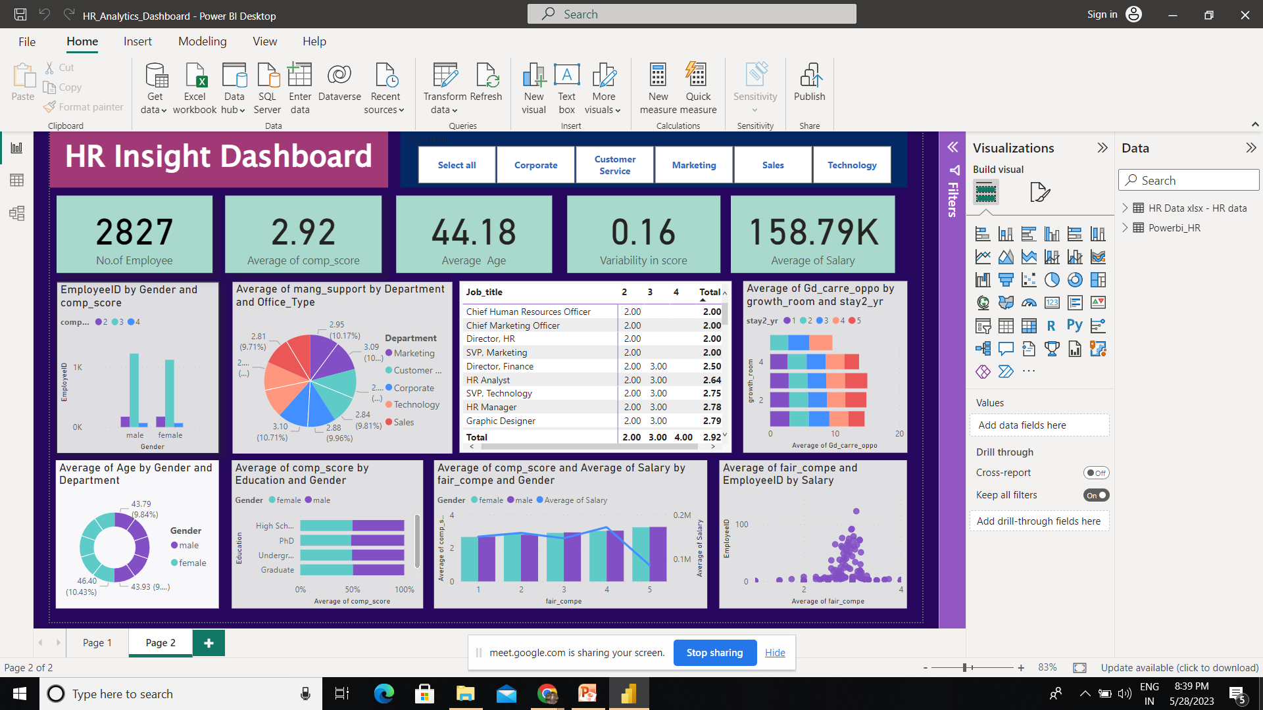
Data Visualization by Power-Bi
Data Insights by Visualization (Power-Bi)

Slide 14
Testing of Hypothesis
ANOVA:
The ANOVA test examines whether there are statistically significant differences in the mean composite scores across different departments and countries.
For department:
H₀: There is no significant difference between the means of departments.
V/s
H₁: There is significant difference between the means of departments.
Output:
F-statistic: 0.34917857053366447
p-value: 0.8447398403474254
For country:
H₀: There is no significant difference between the means of countries.
V/s
H₁: There is significant difference between the means of countries
Output:
F-statistic: 0.34917857053366447
p-value: 0.8447398403474254
Conclusion:
As p value is greater than 0.05
l.o.s, we accept H₀ and conclude that there is no significant
difference between departments
Conclusion:
As p value is greater than 0.05 l.o.s,
we accept H₀ and conclude that there
is no significant difference between
departments.

Slide 15
Chi sq. test for independence:
Chi sq. test for independence:
H₀: There is no association between variable A and B i.e., Independent
H₁: There is an association between variable A and B
Decision rule:
If the p-value is less than
the significance level: "We reject the null hypothesis, indicating a significant association between Variable A and Variable B."
The below heat map shows the
p value for each chi square test
between the categorical variables.
Conclusion:
From this heat map we can say that almost all variables are independent of each other, as we fail to reject the null hypothesis.

Slide 16
Assessment of Multicollinearity using Variance Inflation Factor (VIF):
The VIF values for all Variables {Except(const)}.are close to 1.
Indicating that there is minimal
correlation between the
independent variables.
This suggests that there is no substantial multicollinearity issue among these variables
Constant term (const) has the heighst VIF value which is expected as it represent intercept in the regression model.

Slide 17
Correlation analysis of salary:
Spearman Correlation
Coefficient: 0.07897
The Spearman correlation coefficient measures the strength and direction of the monotonic relationship between variables. In our analysis, the Spearman correlation coefficient between salary and job satisfaction is 0.07897. This value suggests a weak positive correlation between the two variables.
Kendall Correlation
Coefficient: 0.05427
The Kendall correlation coefficient assesses the strength and direction of
the ordinal relationship between variables. For salary and job satisfaction, the Kendall correlation coefficient is calculated as 0.05427. This value indicates a weak positive correlation between the variables.
Both the Spearman and Kendall correlation coefficients demonstrate a similar pattern of a slight positive association.
This suggests that as salary increases, there is a tendency for job satisfaction to slightly increase as well. However, it is important to note that the correlation coefficients are relatively low, indicating a weak relationship between the two variables.

Slide 18


Hey Alexaaa ….
Suggest
The
Ml Algorithm
For
Prediction…??
1.Decision Tree
2.Multiple Linear Regression
3.Random Forest
4.Gradient Boosting
5.Support Vector Machine

Slide 19
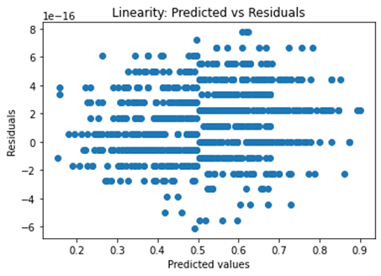
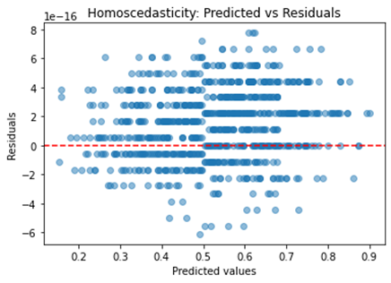
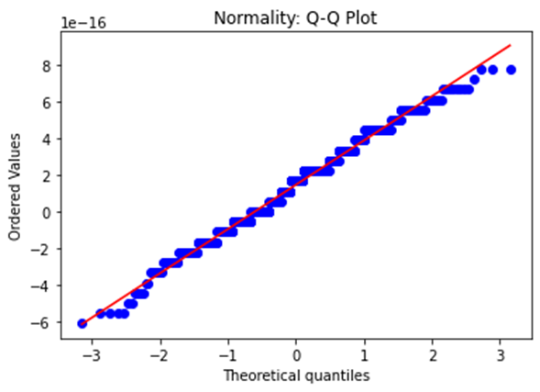
Multiple linear regression:
Assumptions :
1.Linearity
3.Homoscedasticity
4.Normality
2. Independence
Durbin-Watson test statistic: 1.50

Slide 20
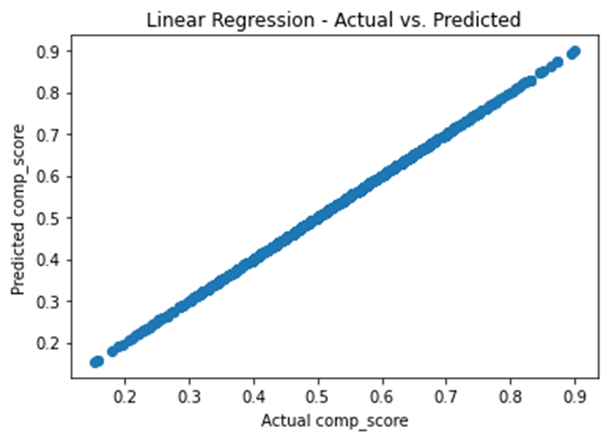
Model Performance:
Sr.No | Metric | Value
1 | Mean Squared Error (MSE) | 7.952356420606328e-32
2 | R-squared(R²) | 1.0
3 | Mean Absolute Error (MAE) | 2.2697746788989426e-16
4 | Root Mean Squared Error (RMSE) | 2.819992273146565e-16
Feature Importance:
Sr.No. | Feature | coefficient
1 | mang_support | 0.2116405
2 | Gd_carre_oppo | 0.2116403
3 | growth_room | 0.1904767
4 | fair_compe | 0.1904761
5 | engage | 0.1904764
6 | recog_for_work | 0.1693126
7 | stay2_yr | 0.1693120
8 | Recomnd | 0.1693128
9 | value_align | 0.1481489
10 | PTO | 0.105820

Slide 21
In conclusion, the multiple linear regression model exhibits strong performance in predicting the target variable.
The selected features have significant coefficients and are statistically significant in the model.
The model's assumptions are met, further reinforcing the reliability of the results. The MSE and R-squared values indicate a good fit of the model to the data.

Slide 22
Random Forest:
Random Forest is an ensemble learning method that combines multiple decision trees to create a more robust and accurate model.
It is widely used for both classification and regression tasks.
Sr.No | Metric | Value
1 | Mean Squared Error (MSE) | 0.00286
2 | R-squared(R²) | 0.8552
3 | Mean Absolute Error (MAE) | 0.04267
4 | Root Mean Squared Error (RMSE) | 0.05349
In summary, the Random Forest model shows good performance, as indicated by the low MSE, high R-squared, and low MAE and RMSE values.
This suggests that the Random Forest model is able to effectively capture the patterns and relationships in the data, leading to accurate predictions of the response variable

Slide 23
Gradient boosting
Gradient Boosting is a powerful ensemble learning method that combines multiple weak prediction models (typically decision trees) in a sequential manner to create a strong predictive model.
Sr.No | Metric | Value
1 | Mean Squared Error (MSE) | 0.00105
2 | R-squared(R²) | 0.9468
3 | Mean Absolute Error (MAE) | 0.02504
4 | Root Mean Squared Error (RMSE) | 0.0324
In summary, the Gradient Boosting model demonstrates excellent performance, The low MSE and RMSE, high R-squared value, and relatively low MAE suggest that the model's predictions are close to the actual values

Slide 24
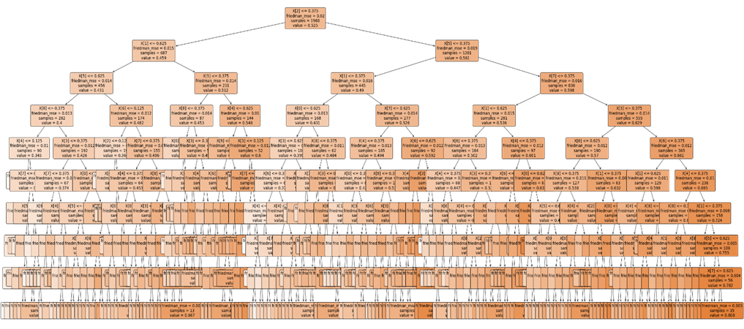
Decision tree:
Decision tree regression is a supervised learning algorithm that can be used for both regression and classification tasks.
It builds a tree-like model of decisions and their possible consequences, allowing for the prediction of continuous target variables.

Slide 25
Sr.No | Metric | Value
1 | Mean Squared Error (MSE) | 0.008526
2 | R-squared(R²) | 0.5689
3 | Mean Absolute Error (MAE) | 0.07427
4 | Root Mean Squared Error (RMSE) | 0.09233
The decision tree regression model demonstrates moderate predictive performance with an MSE of 0.008526547715094984 and an R-squared value of 0.568694584996133.

Slide 26
Support Vector Machine:
SVM (Support Vector Machine) is a powerful machine learning algorithm used for classification and regression tasks. In the context of regression, it aims to predict the values of a continuous target variable.
Sr.No | Metric | Value
1 | Mean Squared Error (MSE) | 0.00154
2 | R-squared(R²) | 0.9221
3 | Mean Absolute Error (MAE) | 0.03186
4 | Root Mean Squared Error (RMSE) | 0.03924
These performance metrics provide an assessment of the accuracy and effectiveness of the SVM model in predicting the continuous target variable.

